Slide 1
Private-Key Encryption Part 3

Slide 2
Last Time
Started an overview of modern private-key encryption
Stream Cipher
Use a pseudorandom generator to generate a keystream to be used as a one-time pad
XOR the plaintext with the keystream to produce the ciphertext

Slide 3
Today
Block Cipher
Drawbacks of private-key encryption

Slide 4
Block Cipher
A block cipher is an encryption scheme for a message block of a fixed size, e.g. 128 bits
How to encrypt a message larger than the block size?
Answer: Mode of Operation
Divide the message into blocks, padding the last one as needed
Repeatedly apply the block cipher to encrypt the blocks
Nontrivial! Will discuss this later in the lecture

Slide 5
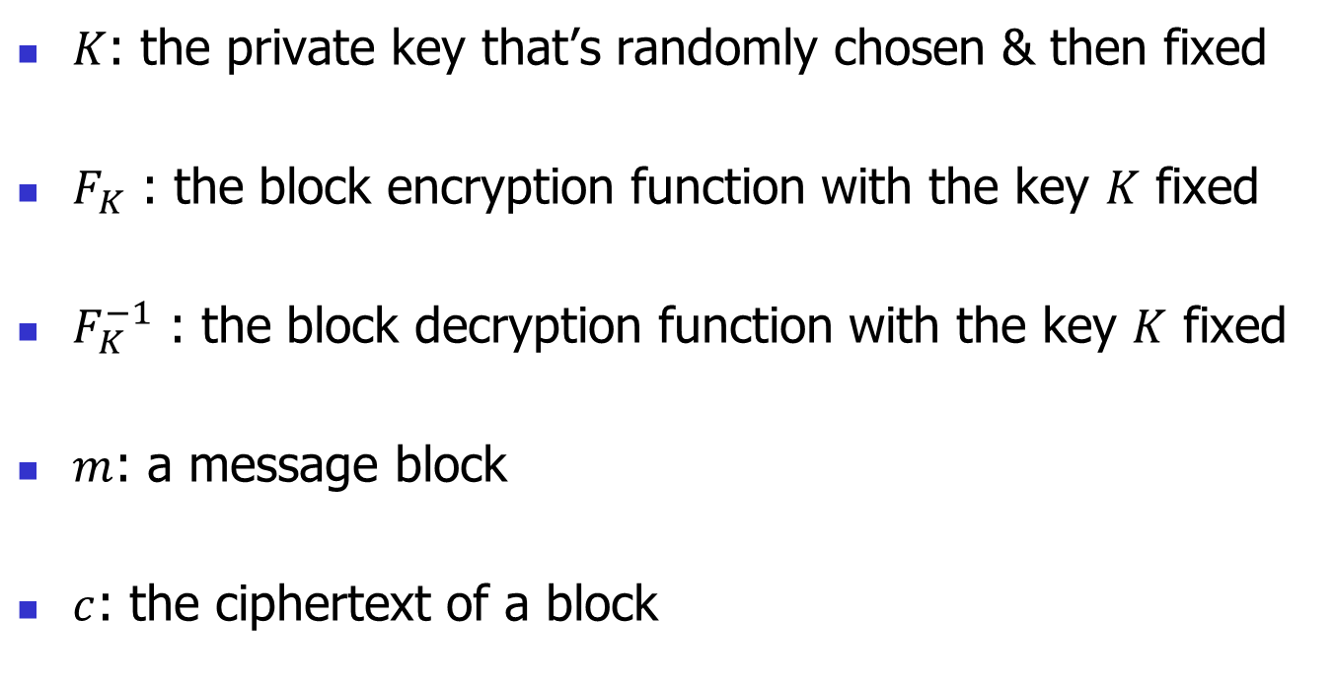
Notations
$K$: the private key that’s randomly chosen & then fixed
$F_{K}$ : the block encryption function with the key $K$ fixed
$F_{K}^{−1}$ : the block decryption function with the key $K$ fixed
$m$: a message block
$c$: the ciphertext of a block

Slide 6






Block Encryption & Decryption
Encryption
Decryption
$$m$$
$F_{K}$
${c=F}_{K}\left(m\right)$
$${m=F}_{K}^{−1}\left(c\right)$$
$${ F}_{K}^{−1}$$
$$c$$

Slide 7
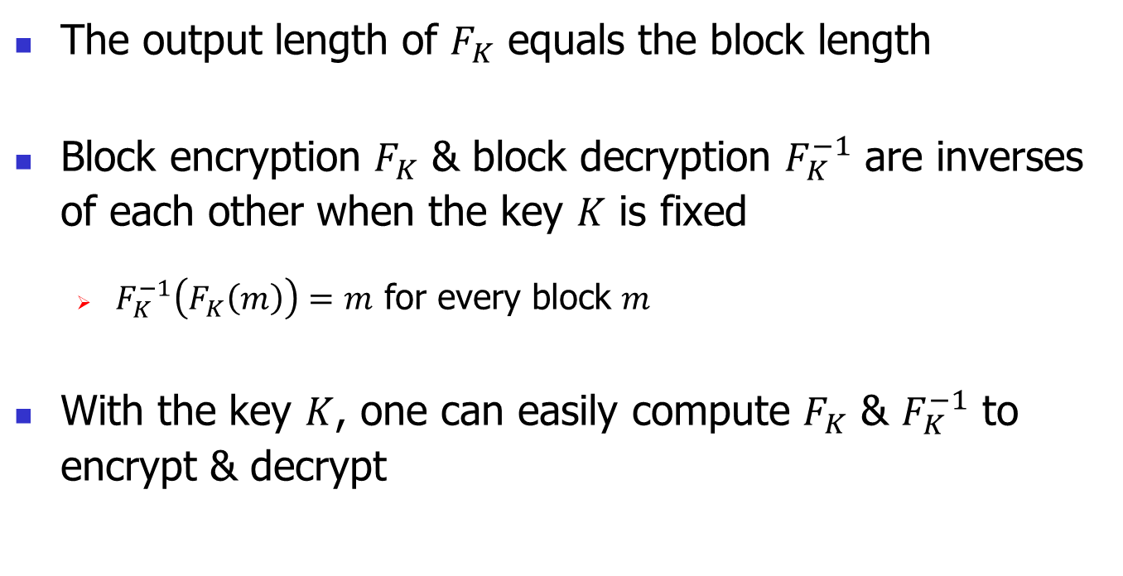
Basic Properties
The output length of $F_{K}$ equals the block length
Block encryption $F_{K}$ & block decryption $F_{K}^{−1}$ are inverses of each other when the key $K$ is fixed
$F_{K}^{−1}\left(F_{K}\left(m\right)\right)=m$ for every block $m$
With the key $K$, one can easily compute $F_{K}$ & $F_{K}^{−1}$ to encrypt & decrypt

Slide 8
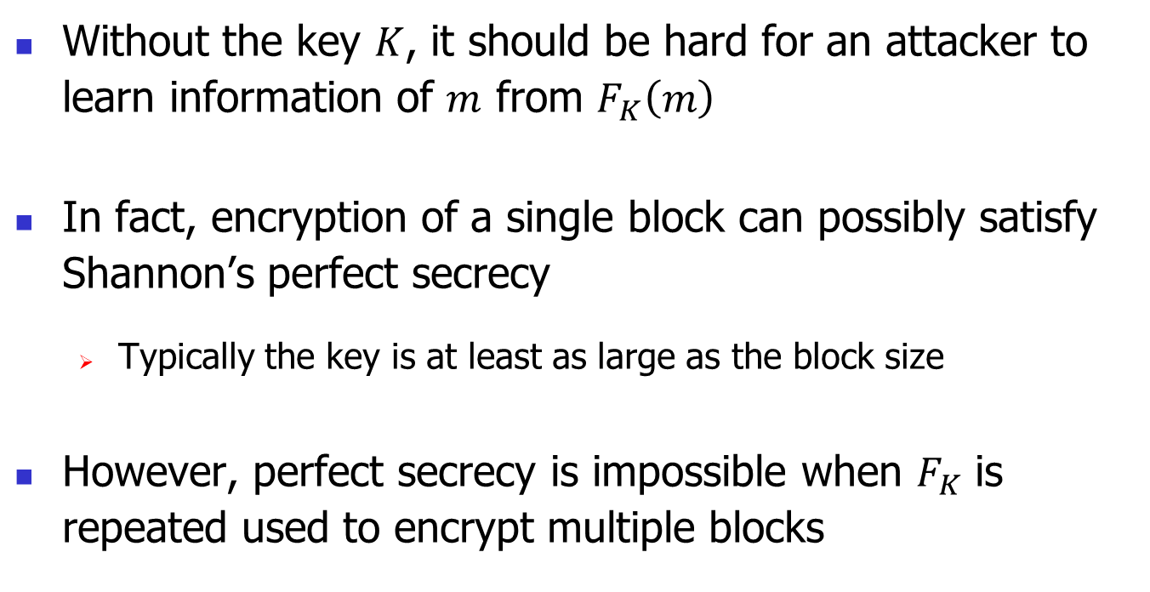
Security of Block Cipher
Without the key $K$, it should be hard for an attacker to learn information of $m$ from $F_{K}\left(m\right)$
In fact, encryption of a single block can possibly satisfy Shannon’s perfect secrecy
Typically the key is at least as large as the block size
However, perfect secrecy is impossible when $F_{K}$ is repeated used to encrypt multiple blocks

Slide 9
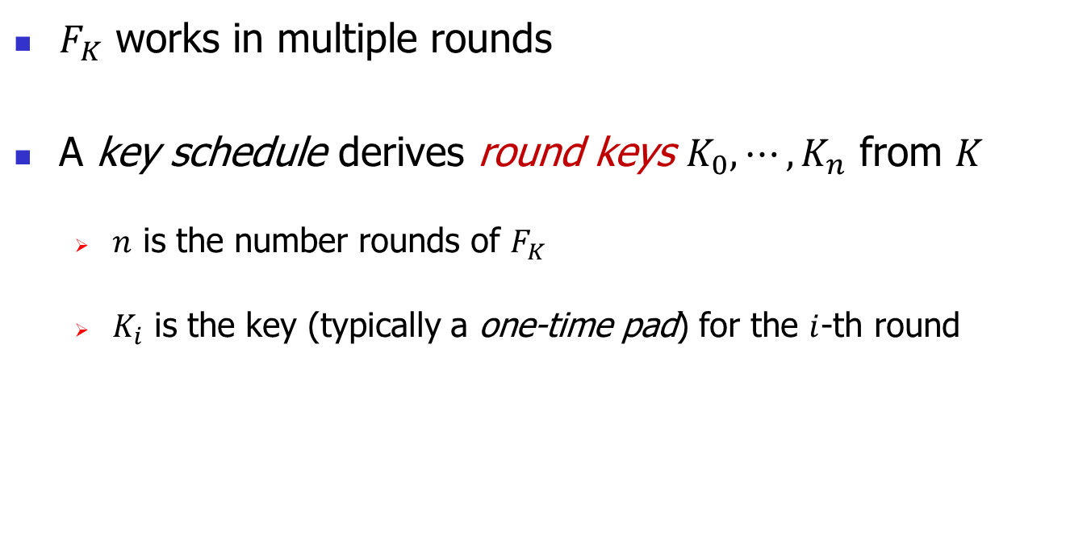
A Few Words on Construction
$F_{K}$ works in multiple rounds
A key schedule derives round keys $K_{0},⋯,K_{n}$ from $K$
$n$ is the number rounds of $F_{K}$
$K_{i}$ is the key (typically a one-time pad) for the $i$-th round

Slide 10
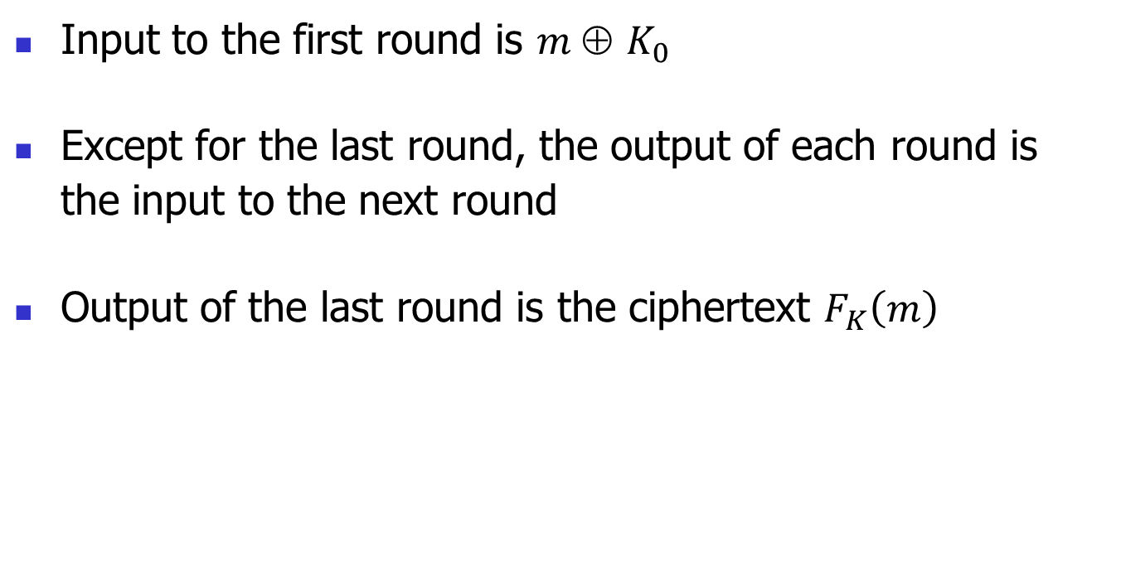
A Few Words on Construction
Input to the first round is $m \text{⊕} K_{0}$
Except for the last round, the output of each round is the input to the next round
Output of the last round is the ciphertext $F_{K}\left(m\right)$

Slide 11
A Few Words on Construction
Each round applies sophisticated operations, including
Substitutions
Permutations
Other invertible transformations
XOR of the result with the round key

Slide 12
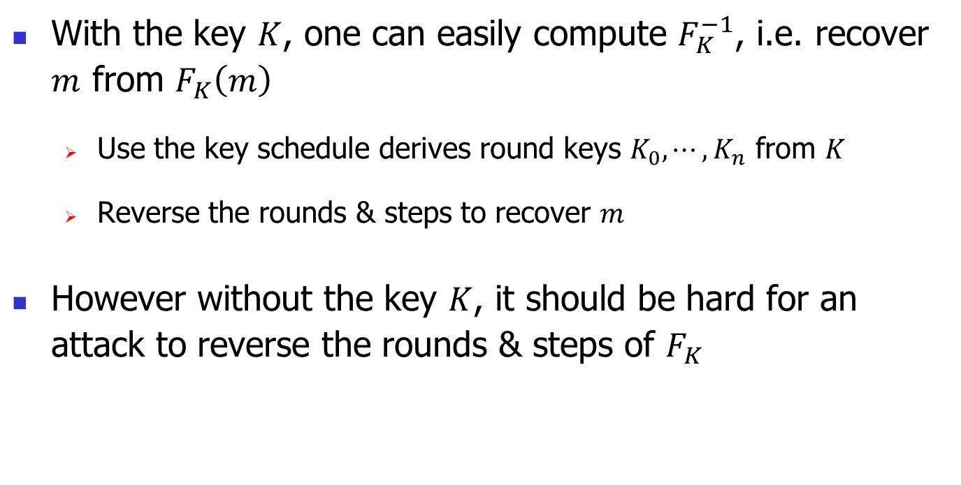
A Few Words on Construction
With the key $K$, one can easily compute $F_{K}^{−1}$, i.e. recover $m$ from $F_{K}\left(m\right)$
Use the key schedule derives round keys $K_{0},⋯,K_{n}$ from $K$
Reverse the rounds & steps to recover $m$
However without the key $K$, it should be hard for an attack to reverse the rounds & steps of $F_{K}$

Slide 13
A Few Words on Construction
Follow this link and that link for an illustration of the construction for AES
Details of the construction are sophisticated & omitted

Slide 14
Standards for Block Ciphers
Data Encryption Standard (DES)
Advanced Encryption Standard (AES)
14
Notes:
14

Slide 15
DES
Developed in 1975 by IBM
In 1976 became the standard for over 2 decades
Key size = 56 bits, block size = 64 bits
Key too short! A major problem
Triple DES often used to enhance security
15
Notes:
15

Slide 16
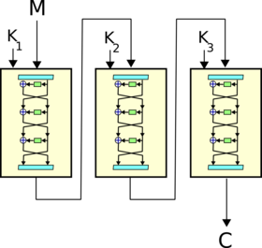
Triple DES
Triple DES: Apply DES 3 times, each time with an independently chosen key
16
Notes:
16

Slide 17
The Break of DES
In 1998, DES was broken!
By Electronic Frontier Foundation (EFF)
EFF cracker cost ∼ $250K & broke DES in 56 hours
Time reduced to 22 hours 6 months later
Today better DES crackers are available
Less time
Lower cost (∼ $10K)
17
Notes:
17

Slide 18
The Break of DES
Lesson learned:
Advances in technology & algorithms give attackers increasingly more power
A system that was secure may be rendered insecure in the future by new technologies & new methods of attack
A new standard was called for
18
Notes:
18

Slide 19
AES
Developed by Daemen & Rijmen in 2001
Became the standard in 2002, replacing DES
By far today’s most used private-key encryption
19
Notes:
19

Slide 20
Ubiquity of AES
Used in
TLS (to protect client-server communication on the Internet)
WPA2 (for Wi-Fi security)
IPSec (to protect Internet traffic at the packet level)
Disk encryption systems, e.g. BitLocker, FileVault
Messaging programs, e.g. Facebook Messenger
…
20
Notes:
20

Slide 21
Ubiquity of AES
Implemented in
C, C++, Java, Javascript, Python
Intel & AMD processors
21
Notes:
21

Slide 22
Basic Properties of AES
Block Size = 128 bits
Key Size = 128, 192 or 256 bits
Number of Rounds = 10, 12 or 14
22
Notes:
22

Slide 23
Security of AES
Security of AES is still not rigorously established
However AES remains unbroken to date
The best-known attacks are not much better than the brute-force approach of trying all possible keys
23
Notes:
23

Slide 24
Block Cipher Mode of Operation
A block cipher is an encryption scheme for a message block of a fixed size, e.g. 128 bits
How to encrypt a message larger than the block size?
Answer:
Divide the message into blocks, padding the last one as needed
Repeatedly apply the block cipher to encrypt the blocks – a method of doing so is called a mode of operation

Slide 25
Many Modes of Operation
Electronic Codebook (ECB) – Insecure
Cipher Block Chaining (CBC) – Secure
Counter with CBC-MAC (CCM) – Secure
Galois Counter Mode (GCM) – Secure
Many other modes…

Slide 26
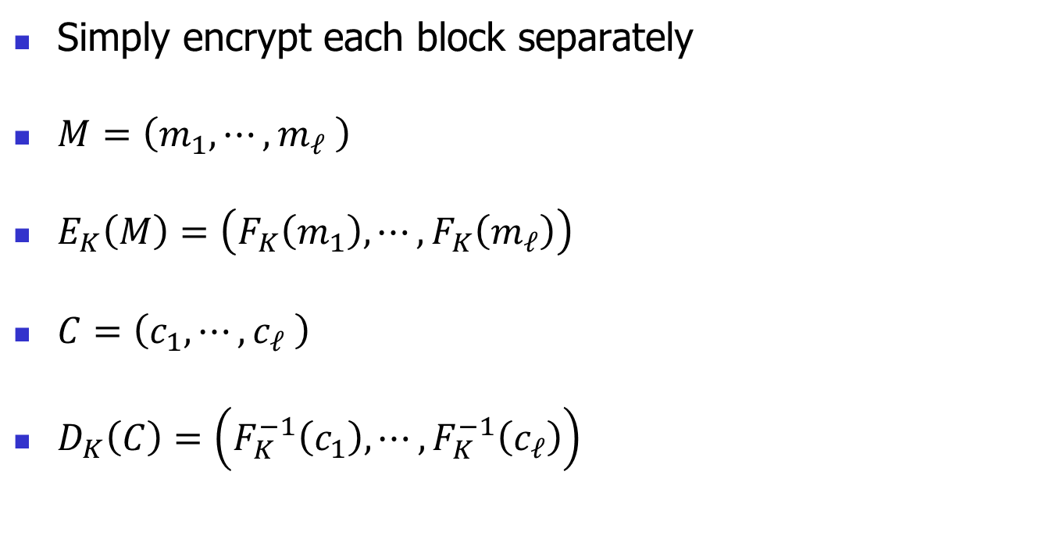
Electronic Codebook (ECB)
Simply encrypt each block separately
$M=\left(m_{1},⋯,m_{ℓ} \right)$
$E_{K}\left(M\right)=\left(F_{K}\left(m_{1}\right),⋯,F_{K}\left(m_{ℓ}\right)\right)$
$C=\left(c_{1},⋯,c_{ℓ} \right)$
$D_{K}\left(C\right)=\left(F_{K}^{−1}\left(c_{1}\right),⋯,F_{K}^{−1}\left(c_{ℓ}\right)\right)$

Slide 27
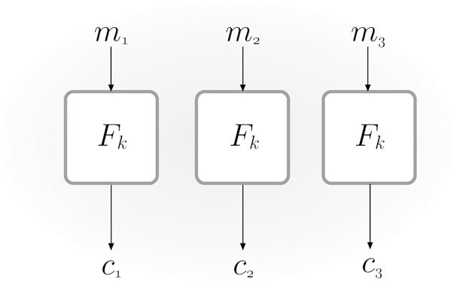
Electronic Codebook (Figure from Katz & Lindel)

Slide 28
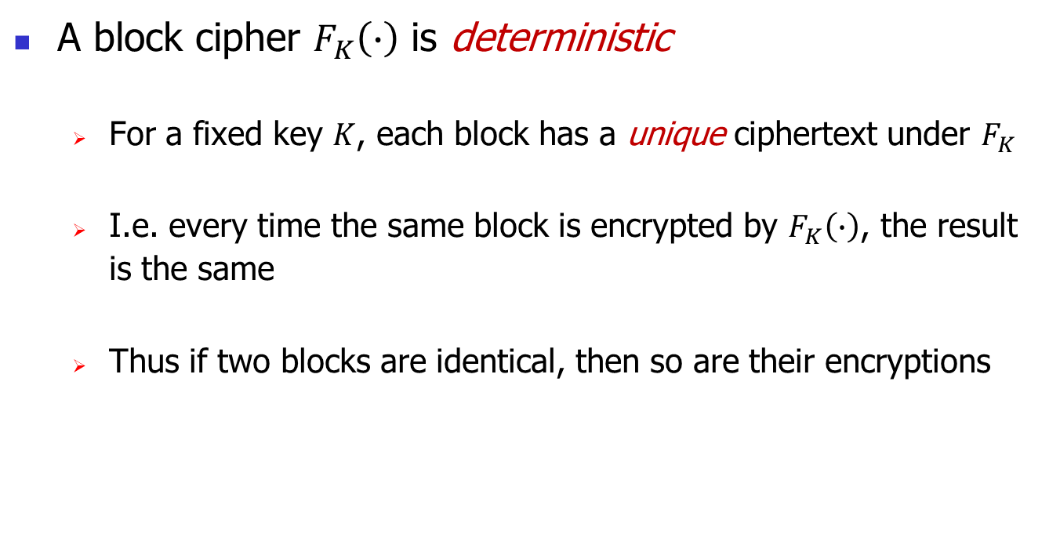
ECB is Insecure
A block cipher $F_{K}\left(∙\right)$ is deterministic
For a fixed key $K$, each block has a unique ciphertext under $F_{K}$
I.e. every time the same block is encrypted by $F_{K}\left(∙\right)$, the result is the same
Thus if two blocks are identical, then so are their encryptions

Slide 29
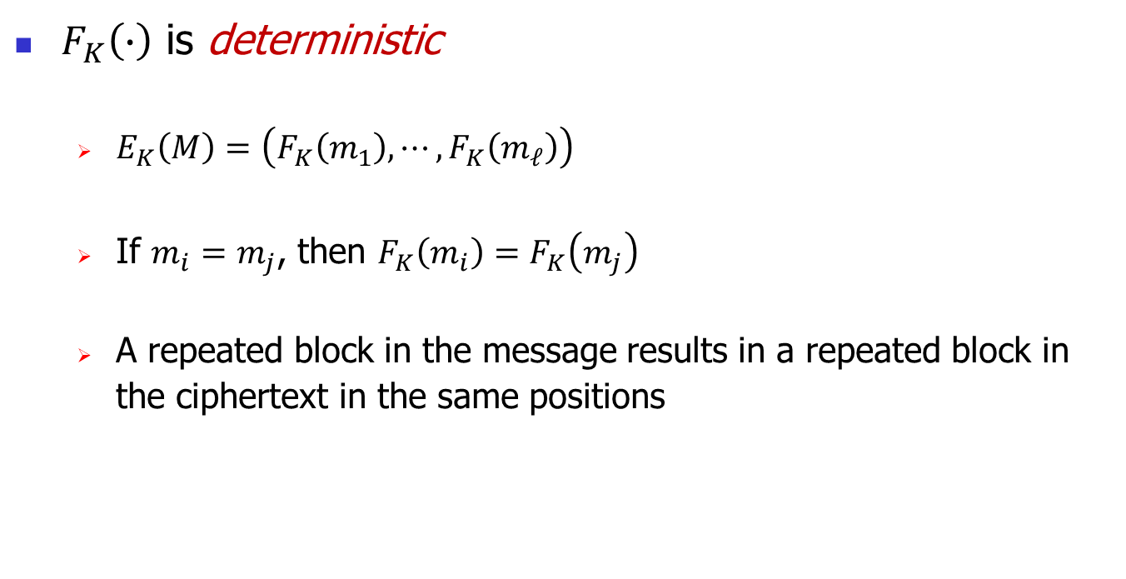
ECB is Insecure
$F_{K}\left(∙\right)$ is deterministic
$E_{K}\left(M\right)=\left(F_{K}\left(m_{1}\right),⋯,F_{K}\left(m_{ℓ}\right)\right)$
If $m_{i}=m_{j}$, then $F_{K}\left(m_{i}\right)=F_{K}\left(m_{j}\right)$
A repeated block in the message results in a repeated block in the ciphertext in the same positions

Slide 30
ECB is Insecure
Follow this link to see an amazing illustration of how insecure ECB is

Slide 31
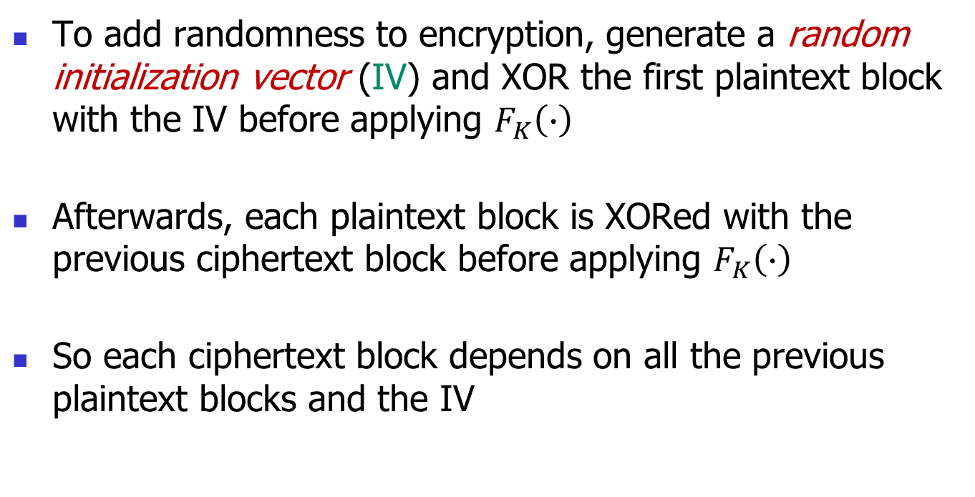
Cipher Block Chaining (CBC)
To add randomness to encryption, generate a random initialization vector (IV) and XOR the first plaintext block with the IV before applying $F_{K}\left(∙\right)$
Afterwards, each plaintext block is XORed with the previous ciphertext block before applying $F_{K}\left(∙\right)$
So each ciphertext block depends on all the previous plaintext blocks and the IV

Slide 32
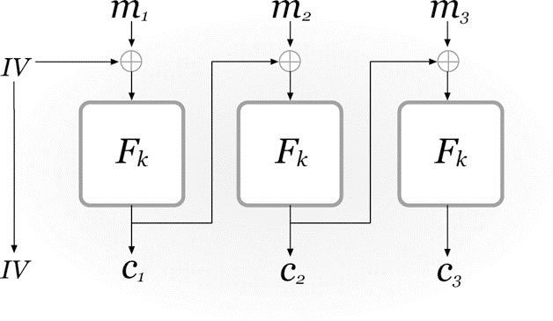
Cipher Block Chaining (Figure from Katz & Lindel)

Slide 33

Cipher Block Chaining (CBC)
$E_{K}\left(m_{1},⋯,m_{ℓ}\right)$
Choose a random initialization vector $IV$
Set $c_{0}=IV$
for $i=1$ to $ℓ$
$c_{i}=F_{K}\left(c_{i−1} \text{⊕} m_{i}\right)$
return $\left(c_{0},c_{1},⋯,c_{ℓ} \right)$

Slide 34
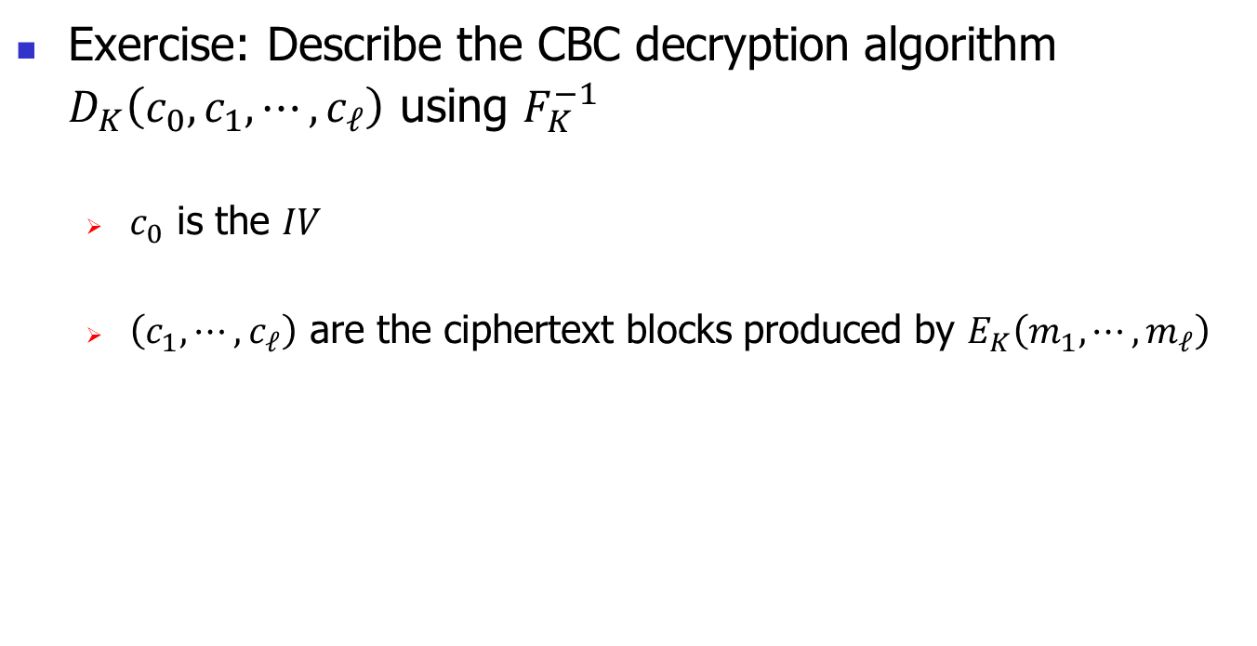
Cipher Block Chaining (CBC)
Exercise: Describe the CBC decryption algorithm $D_{K}\left(c_{0},c_{1},⋯,c_{ℓ}\right)$ using $F_{K}^{−1}$
$c_{0}$ is the $IV$
$\left(c_{1},⋯,c_{ℓ}\right)$ are the ciphertext blocks produced by $E_{K}\left(m_{1},⋯,m_{ℓ}\right)$

Slide 35
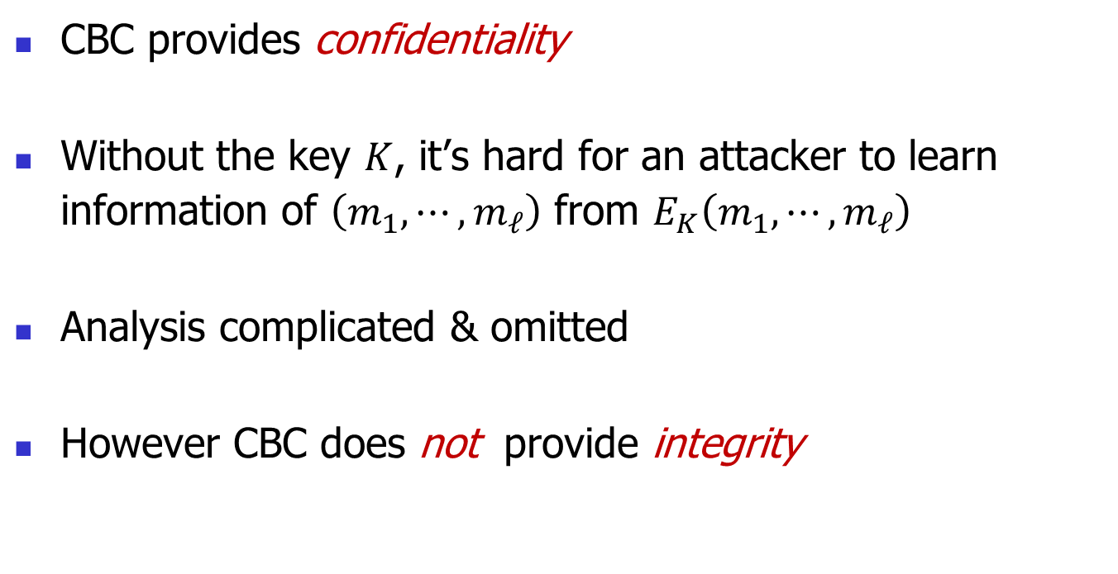
Security of CBC
CBC provides confidentiality
Without the key $K$, it’s hard for an attacker to learn information of $\left(m_{1},⋯,m_{ℓ}\right)$ from $E_{K}\left(m_{1},⋯,m_{ℓ}\right)$
Analysis complicated & omitted
However CBC does not provide integrity

Slide 36
Two Other Secure Modes of Operation
Counter with CBC-MAC (CCM)
Galois Counter Mode (GCM)
Each provides both confidentiality & integrity

Slide 37
Drawbacks of Private-Key Encryption
Sharing a private key securely is nontrivial
Non-Scalability: Need to establish a key with each party to communicate with
Next: Public-Key Encryption

